Slide 1

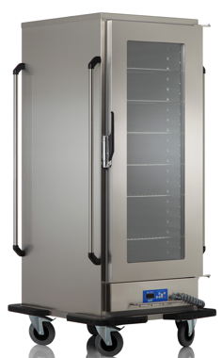

BANQUET TROLLEYS (ELECTRICAL – INDUSTRIAL TYPE)
USER’S MANUAL
OBA 14018 OBA 70182 OBA 70130 OBA 70182 MD
OBAC 14018 OBAC 70182
MANUFACTURER : OZTIRYAKILER MADENI ESYA SAN. VE TIC A.S.
PRODUCTION SITE : Cumhuriyet Mahallesi Hadımköy Yolu Cad. No :8 Büyükçekmece
İstanbul / TURKEY Phone : 0090 212 886 78 00 (8 Hat-Lines) Fax : 0090 212 886 66 29
Our website: www.oztiryakiler.com.tr E-mail: export@oztiryakiler.com.tr
1/13

Slide 2

TABLE OF CONTENTS
PAGE NR. | TOPICS
1 | COVER PAGE
2 | TABLE OF CONTENTS
3 | INTRODUCTION
4 | TECHNICAL DATA
5 | ELECTRICAL CIRCUIT DIAGRAM
6 | WARNING SIGNS
7 | SAFETY DETAILS
8 | TRANSPORTING, MOVING AND INSTALLATION
9 | INTRODUCTION OF THE APPLIANCES
10 | CONTROL BOARDS, OPERATION OF THE DEVICE (1)
11 | OPERATION OF THE DEVICE (2)
12 | CLEAN-UP AND MAINTENANCE
13 | TERMS OF GUARANTEE
CAUTION
This device should only be used in facilities where relevant
standards, laws and safety requirements are complied with
2/13

Slide 3
INTRODUCTION
Dear User,
Thank you for purchasing our device and for your reliance upon our company. Our devices have been used within our customers kitchen, your kitchen in 100 countries. Our devices are produced in compliance with international standards. Important notice: Please read or ensure that the users read this user’s manual in order to achieve the desired performance in line with your expectations and to use your device for long years. Please take the warnings mentioned above into consideration before calling for service...
Please read and ensure that your operation personnel also reads this user’s manual carefully before installing and using the device. If the device is operated without reading the user’s manual, the device will not be covered by the guarantee.
The manual containing information about installation, usage and maintenance of our product you purchased should be read carefully. Please ensure that power supply connections to the device are already installed by qualified personnel according to local legislation, before our authorized service personnel arrives for the installation of the device.
If you are confused or you don’t have enough information
please get in touch with authorized service by phone.
Please keep in mind that, if the service personnel is delayed
at your site, related expenses and delay costs will be charged to
you on hourly basis.
We hope that you will get the best performance from our product…
3/13

Slide 4
TECHNICAL DATA
YOUR DEVICE'S TYPE | OBA 14018 OBAC 14018 | OBA 70182 OBA 70182 MD (FERMENTATION) OBAC 70182 | OBA 70130 OBA 70130
MAIN DIMENSIONS (mm) | 1517X910X1816 | 790X910X1816 | 827X910X1132
TOTAL ELECTRIC POWER (kW) | 2 | 2 | 2
ELECTRIC POWER SUPPLY | 220 – 240 V AC NPE~ / 50-60 Hz | 220 – 240 V AC NPE~ / 50-60 Hz | 220 – 240 V AC NPE~ / 50-60 Hz
THERMOSTAT (°C) | 50-80 | 50-80 | 50-80
CAPACITY | 22 x GN 2/1-100 | 11 x GN 2/1-100 | 5 x GN 2/1-100
SUPPLY CABLE | 3x1,5 | 3x1,5 | 3x1,5
MAXIMUM SLOPE | 5° | 5° | 5°
CLASS | 1 | 1 | 1
PROTECTION CLASS | IP 21 | IP 21 | IP 21
WEIGTH (Kg.) | 220 | 105 | 73
4/13

Slide 5
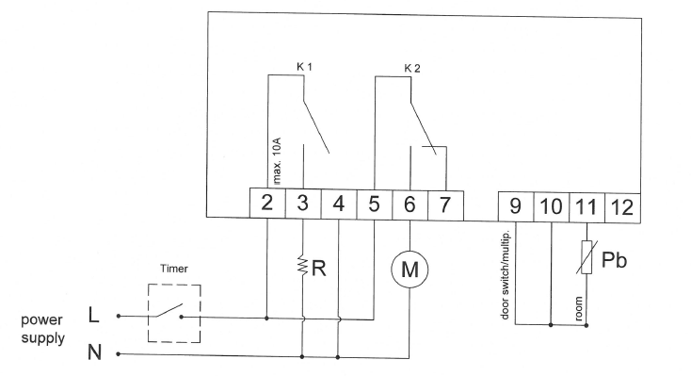
ELECTRICAL CIRCUIT DIAGRAM(BANQUET TROLLEY)
220 V AC
50/60 Hz
R: Heater
M: Fan motor
Pb: Cabin probe
Timer: Valid for prover cabinets
5/13

Slide 6




WARNING SIGNS
PE
POWER NETWORK GROUNDING
GROUNDING
POWER
OVERHEAT
SUPPLY CONNECTION: MONOPHASE
VOLTAGE 220-240 V
GROUNDED
FREQUENCY : 50-60 Hz
6/13

Slide 7




SAFETY DETAILS
Any kind of flammable solid and liquid material (cloths, alcohol and derivatives, petrochemical products, wooden and plastic materials, cutting blocks, curtains etc.) should never be held near the device.
Never leave the device under direct sunlight. It should be located at least 40 cm. away from heat sources like ovens, radiators and heaters.
Use can use this device simultaneously together with
other products of ours.
This device should be installed in line with effective regulations and only be operated in well ventilated places. Please refer to the instructions before installing and operating the device.
This device is designed for industrial use and should only be operated by personnel trained on the device.
The device should not be handled by anyone else except for the manufacturer or authorized service..
In case of fire or flame in the area where the device is operated, act without panic, close gas valves (if any),
turn off power switches and use a fire extinguisher.
Never use water to extinguish the fire.
7/13

Slide 8
TRANSPORTING, MOVING AND INSTALLATION
Heated unıts are be delivered as a standard in wooden cases, reinforced by EPS block, wrapped with stretch film and air bubble protective packing, and wrapped over again with a second layer of stretch film
The device may be moved with manpower.
Do not hit or drop the device when moving.
CHANGING THE LOCATION;
Machines installed by an authorized service CANNOT BE
MOVED ELSEWHERE, ITS POWER SUPPLY CABLES
CANNOT BE EXTENDED OR REPLACED except by
an authorized service.
If this device located near to any wall, separation, kitchen furniture, decorative coating etc. the distance in between should be 20 cm. and if those
are coated with fireproof heat insulating material, the distance should be 5 cm.
It is strong recommended that fire safety protection instructions are observed.
  Remove stretch film on the device before installing the device.
  After the device is moved to the location where it will be operated, rollers should be set to lock position. In this way sliding of the trolley is prevented.
  Power supply connection of the device should be checked by an eligible electrician, and it should be connected to a fuse at a maximum height of 170 cm.
  Power supply connection should be made using a 30 mA current leakage fuse as a protection against current leakage danger.
  Power installation of the plugs to be used should be grounded by connecting it to a grounding bar at the nearest panel.
8/13

Slide 9
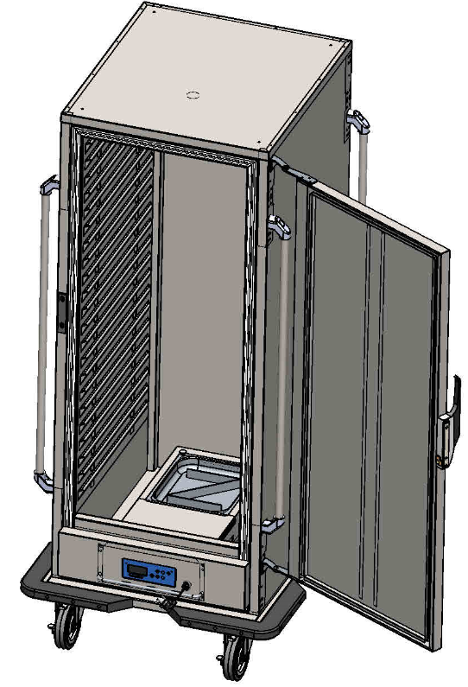
INTRODUCTION OF THE APPLIANCES
handle
rails
Door lock
water container
Timer (for MD models)
Control panel
castor with brake
9/13

Slide 10
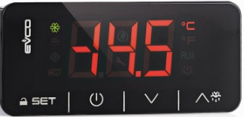
OPERATION OF THE DEVICE (1)
CONTROL BOARDS
Banquet trolley is used in kitchens of restaurants, fast food stands, canteens, hospitals in order to keep foods warm and ready for service.
Before initial use of the device, the outer surface should be wiped with a cloth soaked in warm water and soap.
The control panel provides the following controls and functions:
SET key
  Use to enter/set input values
ON/OFF key
  Hold down for 4 seconds to turn the cabinet on or off
DOWN key
  Use to scroll down through the menu or to change/reduce the value
UP key
  Use to scroll up through a menu or to change/increase the value
FRONT PANEL FUNCTIONS
The control panel can be locked and unlocked.
To lock the controls:
Ensure that no procedure is in progress
Do not operate for 30 seconds
The display will show “LOC” for 1 second and the keyboard will lock automatically
To unlock the controls:
Touch a key for one second: the display will show the message “UNL” for one second
TEMPERATURE SETTING
Ensure that the control panel is not locked and that no procedure is on progress.
Touch the SET key, the * LED will flash.
Change the temperature setting by the use of the UP and DOWN arrows.
Touch the SET key or do not operate for 15 secs. The * LED will stop showing and the controller will exit this procedure.
To exit the temperature setting procedure before it is complete.
Touch the ON/OFF key (any changes will not be saved). The working set point can also be set via the SP parameter.
SETTING OF OPERATION TIME (AVAILABLE FOR OBA 70182 MD MODELS)
The timer is set to the desired run time.
The device will shut down after a period of time.
NOTE: Do not use except purpose of use. The device should be operated by qualified personnel knowing safety terms and technical specifications and who has read the instruction manual.
  CAUTION !
  NEVER OPERATE YOUR DEVICE
  WITHOUT GROUND CONNECTION.
10/13

Slide 11

OPERATION OF THE DEVICE (2)
CAUTION! The device should move just on smooth surfaces!
CAUTION! : The device should be installed and operated as described in this user’s manual. If any failure is encountered please contact our nearest authorized service dealer.
WHEN THE DEVICE HAS A FAILURE ONLY AUTHORIZED …………………… SERVICE DEALERS ARE ALLOWED TO HANDLE THE DEVICE. IF ANY PERSON OTHER THAN ONLY AUTHORIZED SERVICE DEALERS HANDLE THE DEVICE, IT WILL NOT BE COVERED BY THE GUARANTEE.
NEVER ALLOW PEOPLE WHO ARE NOT AUTHORIZED TO HANDLE THE DEVICE. OTHERWISE PRODUCER COMPANY WILL NOT BE RESPONSIBLE FOR THE CONSEQUENCES. DURING MAINTENANCE SERVICE OUR AUTHORIZED SERVICE DEALERS SHOULD NOT BE PROPOSED TO USE NON-ORIGINAL SPARE PARTS FOR WHATSOEVER. INSTALLING ANY NON-ORIGINAL SPARE PART TO THE DEVICE LEAVES THE DEVICE OUT OF GUARANTEE COVERAGE.
11/13

Slide 12
CLEAN-UP AND MAINTENANCE
  After using device, disconnect your device from power supply, by unplugging it or switching it off, before carrying out periodical clean-up.
  Clean your device with liquid dishwashing detergent and a piece of cloth or sponge soaked in warm water. Then in order to remove detergent residuals rinse it with a piece of cloth soaked in clear and warm water. Never use abrasive and aggressive cleaning agents like thinners, bleachers, powder detergents.
  For cleaning door gasket, only use warm water and soap. Do not use detergent or other cleaning agents. Otherwise vacuum feature of the gasket will be harmed.
  Be cautious during the clean-up, that water does not get into control boards.
LIFE OF USE
Devices life of use is 10 year if it is used under recommended conditions.
  CAUTION! :
  Never use combustible, flammable and abrasive materials for cleaning, like gasoline, gas, thinner, acid for cleaning.
12/13

Slide 13
TERMS OF GUARANTEE
  1- Documents without sales date, factory and sales company approval on, are not valid. In order to benefit from the guarantee, guarantee document should be presented.
  2- If the device is installed and operated following the instructions in the installation, maintenance and user's manual, it is warranted for failures resulting from failures resulting from workmanship and material failures.
  3- The failures within the scope of guarantee, how and where these will be eliminated, and the way and place of maintenance is determined by ................
  4- The guarantee is only valid provided that the guarantee terms and the instructions in the installation, maintenance and user's manual are fully complied with. The guarantee is only valid for the warranted device, and no other right or compensation for some other thing may be claimed.
  5- If the information about the kind and the type of the device, serial numbers printed on the guarantee document are scraped, rubbed or changed, then the guarantee is not valid.
  6- The guarantee covers only maintenance and repairing of material or workmanship failure within the valid guarantee period. Failures and parts within the scope of the guarantee are repaired and replaced without any charge. Replaced parts belong to ................
  7- The failures occurring in the device may only be handled by service personnel authorized by ................ If people who are not authorized handle the device, it will not be covered by the guarantee.
  8- Installation should be carried out by authorized service personnel and the service should be informed about the location change of the device.
  9- When any failure occurs during operation, authorized service dealer should be contacted.
  10- Guarantee does not cover failures and damages resulting from loading, unloading and shipping, which are outside the responsibility of ................ Similarly, failures and damages resulting from external factors are not covered.
13/13

